Slide 1
Introduction to Information Processing

Slide 2
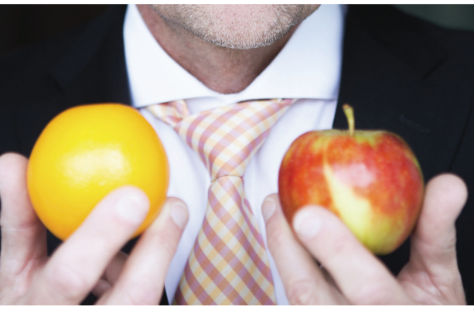
What is the use if analysing data on the general population?
Do you know that most people prefer apples over oranges? However, data shows that an average Ethiopian prefers oranges over apples. What will happen if no data is collected and analysed?

Slide 3

Information System
1.1
Do you know how libraries keep track of the status of the huge amount of books? How the status of books are updated when borrowed or returned?
Libraries can achieve this with the help of information systems.

Slide 4
Purpose
A
Information systems are implemented to:
Automate processes
Reduce human errors
Improve efficiency

Slide 5
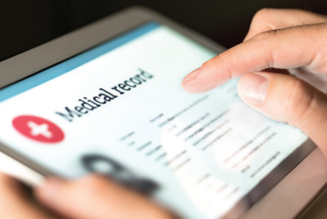
Data
B
Data is stored in computer storage devices, it can be used by programs for input or output.
Examples of data include:
Medical history of a patient
Weather data

Slide 6
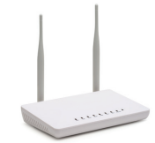

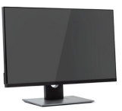
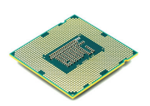
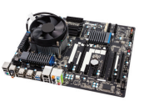
Technology
C
Hardware refers to the physical devices used in an information system:
Processing | Connection of system units | Network communication | Input | Output
Central processing unit (CPU) | Motherboard | Home router | Microphone | Monitor

Slide 7
Technology
C
Software refers to the programs running in an information system:
Types of software |  | Software
System software | Operating system | Microsoft Windows and macOS
 | Utility program | Task Manager and anti-virus software
 | Driver program | Driver programs for a sound card, a USB flash drive or a printer
Application software |  | Word processor and database management software (DBMS)

Slide 8
Process
D
Process is the series of steps to ensure the data and the related analysis can achieve the purpose precisely.
Data should be processed in a meaningful way to convert it into useful information.

Slide 9
Personnel
1.1
Information systems are managed by different personnels:
Computer Engineer | System Analyst | Programmer | Technical Support | Network Manager | Database Administrator
Design, build and integrate the hardware, software and network | Design a system to fulil the business needs and the requirements provided by end users Analyse the time, cost and feasibility of building the system | Develop the system according to the design given by systems analysts | Assist the end users in using the information system | Monitor the network communication between computer systems | Design and manage the databases

Slide 10
1.1
Answer the question on P. 8 of the textbook.
D

Slide 11
Data and Information
1.2
Do you know what is the meaning of the data below?
81
Boatman
Olympia
70
Paris
Hamilton
45
73
Baker
Merchant
49
Fisher

Slide 12
Data
A
Data is a collection of unorganised facts which usually has no meaning on its own.
81
Boatman
Olympia
70
Paris
Hamilton
45
73
Baker
Merchant
49
Fisher

Slide 13
B
After processing, data is put into context and converted into information.
For example:
First name | Last name | Gender | Age | City of Residence | Occupation | Weight | Score | Grade
Brooklyn | Fisher | M | 45 | Sydney | Boatman | 49 | 44 | F
Paris | Merchant | F | 24 | Olympia | Baker | 62 | 81 | B
Hamilton | Miller | M | 37 | Richmond | Blacksmith | 70 | 73 | C

Slide 14
Input-process-output cycle
C
Input-process-output cycle (IPO cycle):
Data is input into the computer.
The computer processes the input data.
Meaningful information is output from the computer.

Slide 15
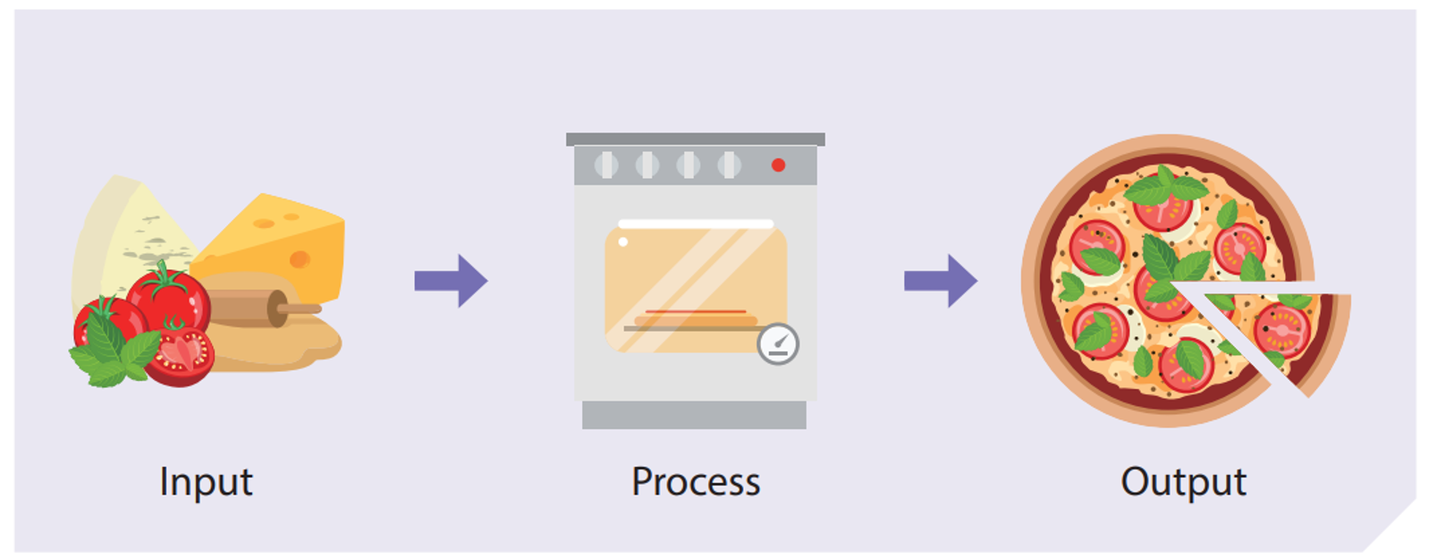

Slide 16
1.3
Write down which is data and which is information on P. 9 of the textbook.
Item | Net income of a company | Growth rate of the net income of a company
 | Data | Information
Item | Heights of the students in Class 1A | Name of the tallest student in Class 1A
Item | Average temperature of room 101 | Hourly temperature of room 101
Item | Raw footage of a speech | Transcript of a speech
Item | Number of cats in a real life photo | A real life photo of cats
Data
Information (by sorting)
Information (by calculation)
Data
Data
Information (by speech recognition, etc.)
Information (by image recognition, etc)
Data

Slide 17
Data Type in Multimedia
D
Text includes various types of characters:
numbers
letters
symbols
Text in different languages may use different encoding systems.
Character encoding system | Language
ASCII | English
Big5 | 繁體中文

Slide 18
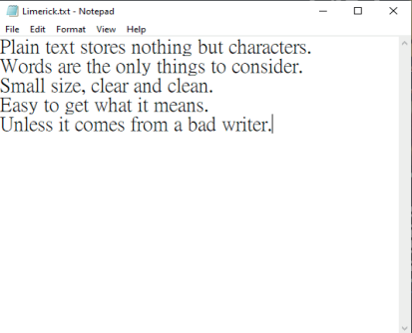
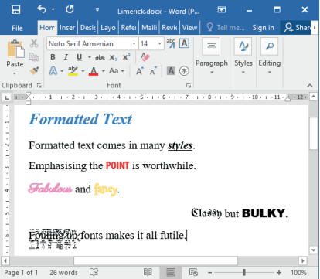
Data Type in Multimedia
D
There are two types of text:
Plain text | Formatted text
Stores characters only | Stores characters and their formatting data

Slide 19
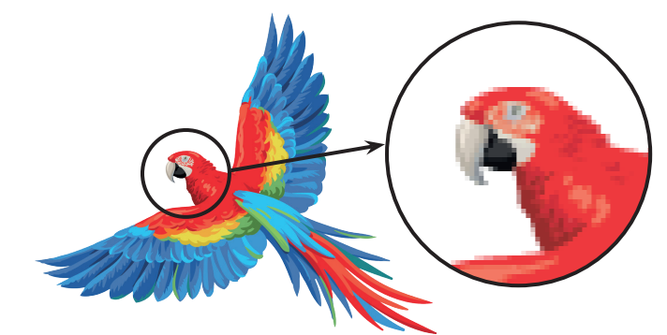
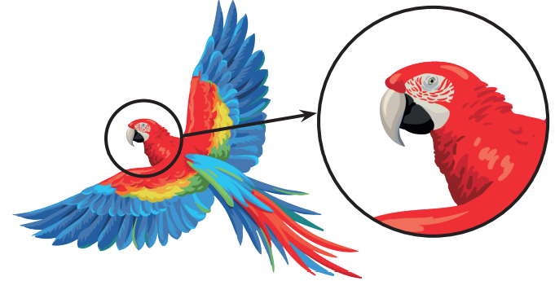
Data Type in Multimedia
D
Digital images are images captured by digital cameras or made with image editing software.
There are two types of images:
Bitmap images | Vector images
Stored as a series of little squares called pixels | Stored as mathematical formulae

Slide 20
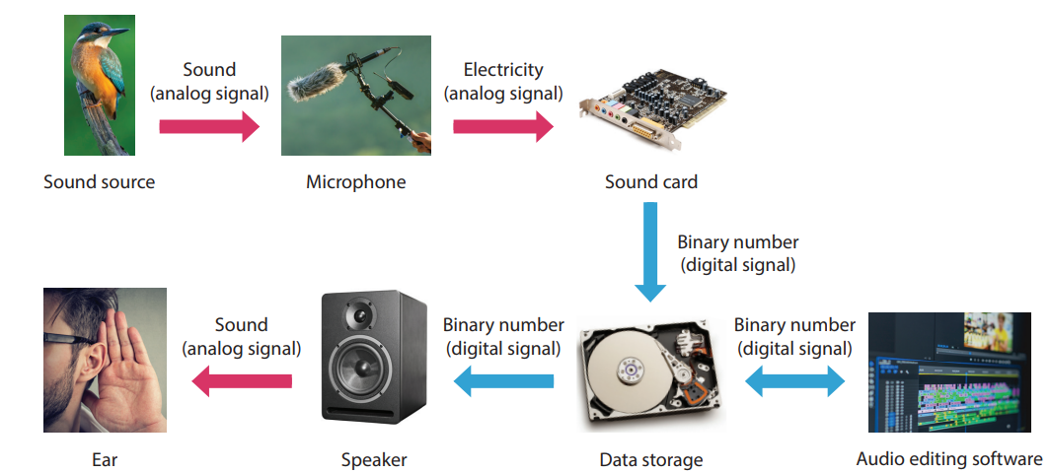
Data Type in Multimedia
D
Digital audios are data that can be converted to sounds.
Analog signals are converted into digital signals, and stored as digital audios:

Slide 21

Data Type in Multimedia
D
Videos are combinations of images and audios.
By showing a collection of images within a short duration of time, a moving image is created:

Slide 22
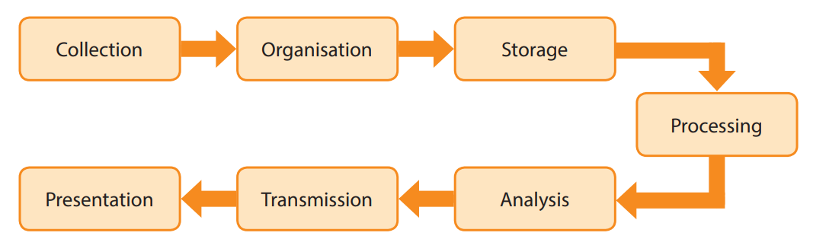
Information Processing
1.3
Information processing converts raw data into meaningful information. There are seven stages of information processing:

Slide 23
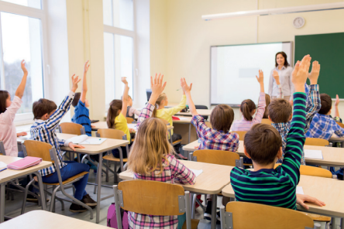
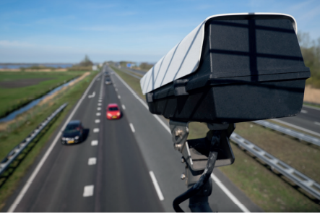
Data collection
A
Data can be collected by various methods like observation, experiments, interviews, surveys, etc. The data collection method depends on the scope and the data type.

Slide 24
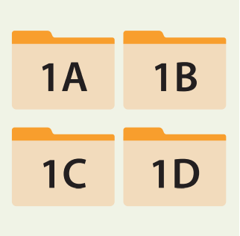
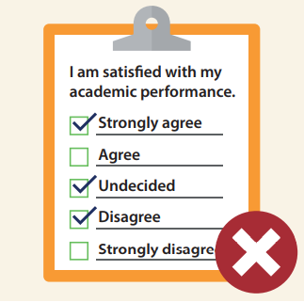

Organisation
B
Organisation means managing, categorising and classifying the collected data in a specific way, examples include:
Data arrangement | Data validation | Data type conversion

Slide 25
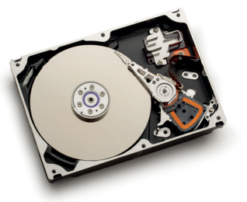
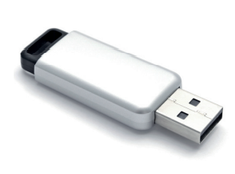
Storage
C
After organisation, Data can be stored as physical copies or in a digital storage.
Common digital storages include:
Hard disk | USB flash drive

Slide 26
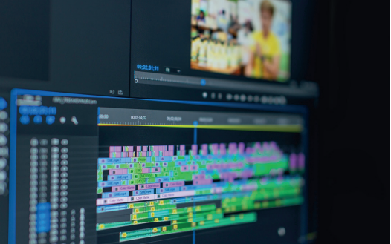
Processing
D
Processing means editing, modifying and updating data. The can be categorized as:
Text processing
Image processing
Audio processing
Video processing

Slide 27
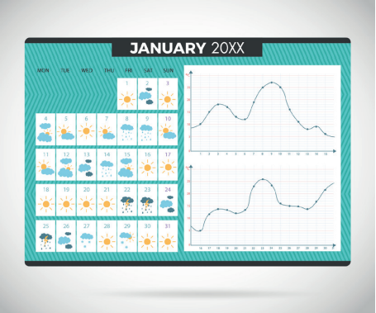
Analysis
E
Data analysis extracts meaningful information from the processed data. For example:
Putting the annual average temperature of Hong Kong in the past 50 years into a spreadsheet to identify the climate trends

Slide 28

Transmission
F
Data transmission involves transmitters, media and receivers.
Network is one of the possible media. It requires that both the transmitter and the receiver use the same protocol for communication.

Slide 29
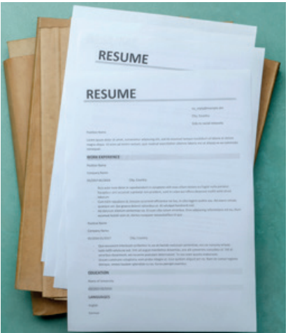
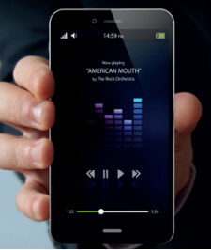
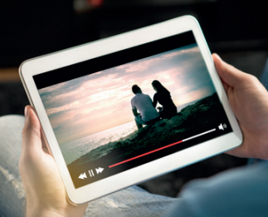

Presentation
G
Presentation means the output of data or information through various media. Common examples include:
Text | Image | Video | Audio

Slide 30
1.1
Diana is making a reality show. She has over 200 footages stored in her computer. Which of the following are proper ways for her to search footages more efficiently?
(1) Subtitling the footages
(2) Stating the creation date in the filenames of the footages
(3) Putting the footages filmed in the same week into one folder
(1) and (2) only
(2) and (3) only
(1) and (3) only
(1), (2) and (3)

Slide 31
1.1
Analysis
(2) allows us to search footages by their creation date. (3) helps us find all the footages filmed in the same week. (1) makes the footage more accessible but does not make the searching easier.
Solution
The answer is B.

Slide 32
Information Age
1.4
What will happen to your life without computers?

Slide 33
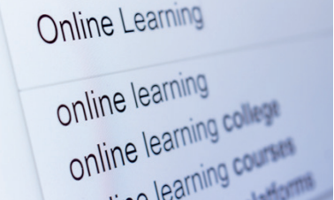
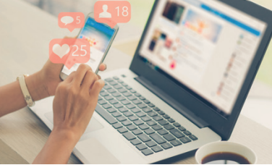
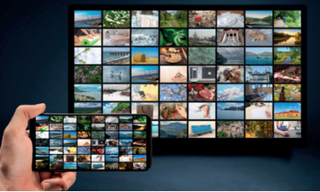
Definition
A
With the rapid development of information and communication technology, microcomputers, internet and search engines have been improved constantly.
Accessing and publishing information have become easier and more popular:
Search engine | Social media | Streaming platform

Slide 34
Causes
B
The causes of the information age include:
Personal computers and mobile devices | Application design | Communication network
Personal computers and mobile devices have become more widespread as they are more affordable. The computing power of mobile devices has increased over the years, which allows users to process and transmit data anytime and anywhere. | Interactive design of software allows people to access desired information directly. | The invention of optical fibres and the advancement of telecommunication technology have enhanced the mobility and the coverage of information.

Slide 35
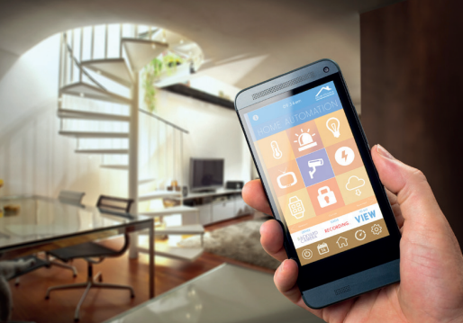

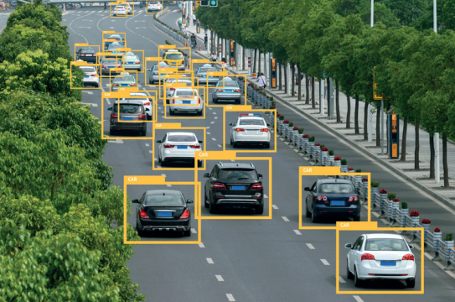
Development
C
The developments of information and communication technology include:
Internet of Things | Big Data | Artificial intelligence
Network of physical objects | The vast amount of data gathers due to the high usage of digital devices and online platforms | Has the power to process and analyse a large amount of data in a short time.

Slide 36

Information Literacy
D
We should consider information literacy from different aspects before accepting and using information.
Intellectual property | It is unethical and illegal to use or gain benefits from others’ intellectual properties without their permission.
Data privacy | When sharing information, we should respect others’ privacy.
Credibility | We should consider the authoritativeness, validity and relevance of the information.
Extraction and organisation | We should search information from various media, then extract and organise our findings.

